Slide 1
Interface Design
AT2

Slide 2
Introduction
Notes:
The UI for this database allows the user to save and edit the data of tables containing information about various bands, musicians and their respective shows, instruments and skills
A series of forms and menus have been created to facilitate the process of adding or editing information within their respective tables.
These forms have been designed with an ease of use philosophy, with simple labelling and navigation mechanics that will allow users of all skill levels to autonomously engage with the database.

Slide 3
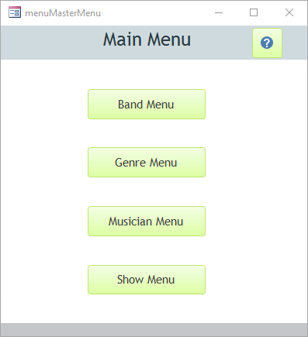
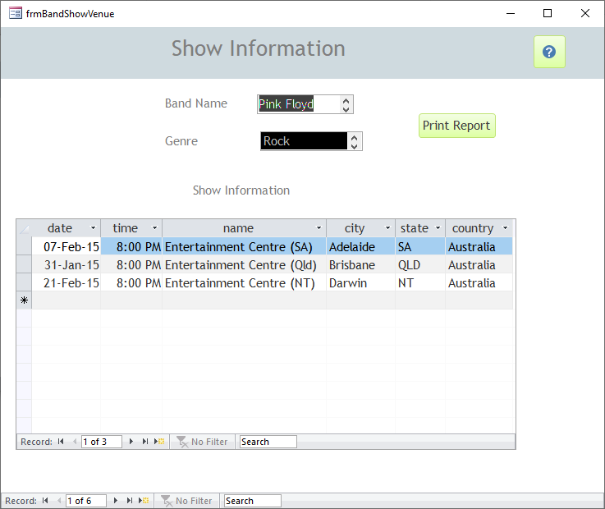
Colour Scheme
Notes:
The UI for this database has implemented a white, lime green and grey blue colour scheme.
This scheme was used to maintain readability and provide and “easy on the eyes” interface.
The background of all forms is a simple stock white. This allows all information displayed within the forms to maintain readability. Simplicity and ease of use is the primary goal of this UI.
The header background and header text use two variations of a neutral grey blue colour. This allows the header to stand out from other information displayed within the form and improves the ease of navigation throughout the various forms.
All buttons located throughout the forms and menus are a bright lime green with automatic black font. This was chosen to give the forms some life and contrast with the neutral colours of the background and form headers. It also serves to create a distinction between navigation buttons and other information displayed on the forms and menus, once again reinforcing the UI design philosophy of simplistic ease of use.

Slide 4
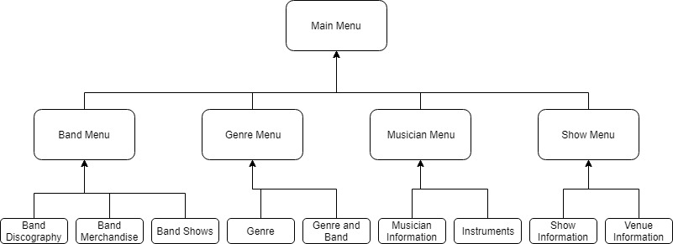
Navigation
Notes:
Form navigation has been designed around the categorisation of various tables and the data that their respective forms display.
The main menu features as a starting and return point for all of the submenus and forms. It contains 4 buttons which direct the user to separately defined menus. These are; the Band Menu, the Genre Menu, the Musician Menu, the Show Menu. These submenus contain the buttons that will direct the user to the appropriate form depending on their needs. All forms can be accessed through the menu navigation systems.
Each form also has a help button included in the top right corner, to assist the user with form and record navigation.
To print the show report, navigate through the Band Menu to the Band Shows forms. There is a “Print Report” button located in the top right corner of the form that will allow the user to generate a report of all of the show information.

Slide 5
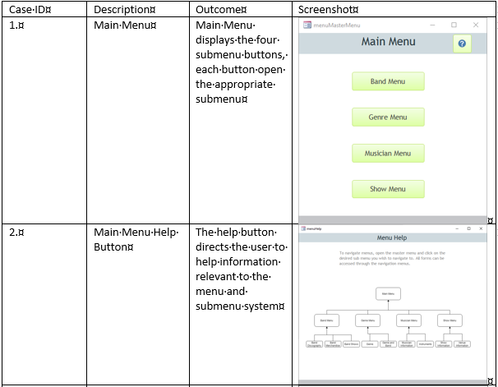
UI Testing
Each individual menu and form has been tested to ensure that all elements within the UI function correctly

Slide 6
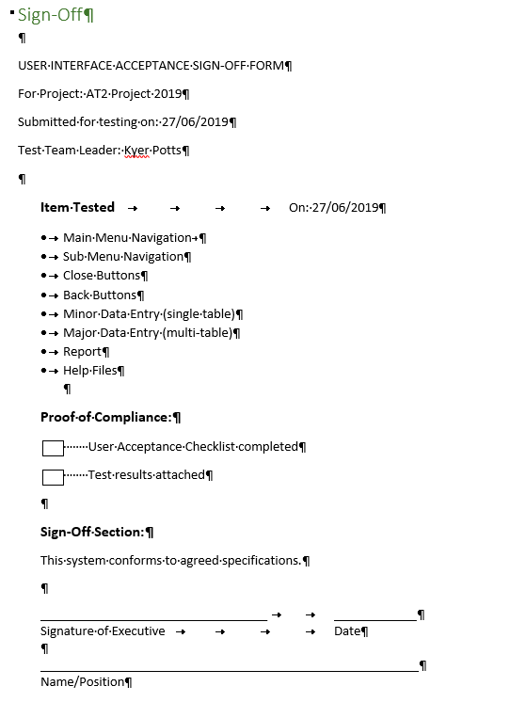
Sign-Off
Sign-Off is required to ensure that all items of the project have been completed successfully and the project is ready for deployment.

